Slide 1

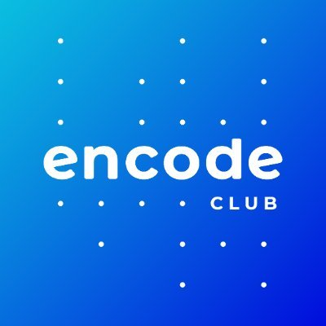
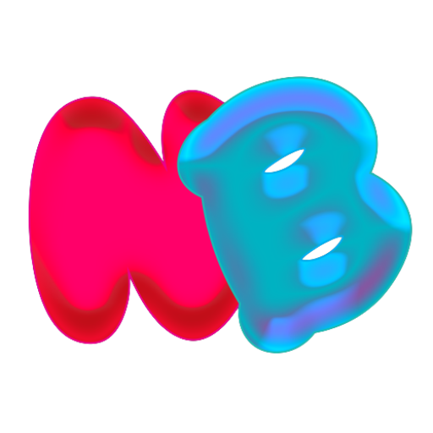
NOTIBOY
Decentralized Communication Protocol on Algorand

Slide 2



Team
Vidhyanand CS Marketing & UI
DEEPAK S Blockchain Developer
2nd Prize in Algorand Greenhouse Hackathon 1

Slide 3
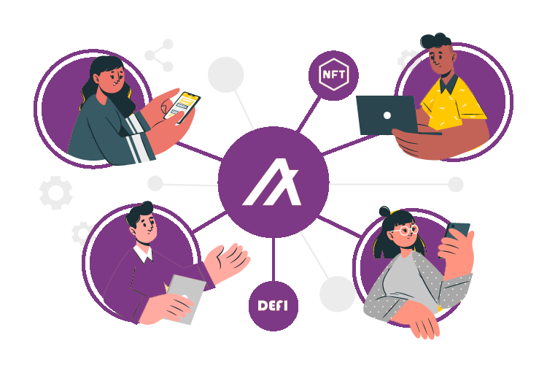
Problem
Difficulty in tracking interactions with multiple applications for end users
dApps do not have a medium to communicate on-chain events
Lack of address to address communication

Slide 4
Notiboy
Addresses to address communication
Public and personal notifications
Fully on-chain, zero infra, zero downtime
Utilizes low cost of transactions & instant finality of Algorand
Defi Protocols, NFT Marketplaces, Web3 Games, DAOs

Slide 5


Products
Basic Channels
Subscription Channels

Slide 6


Traction
10 Channels Created
120 Notifications Sent

Slide 7
Future
Enhance JS SDK and Web App UI
Android & iOS Apps
DART SDK for dApp’s Mobile App Integration
Adopt Box Storage for Scalability
Inter-chain communication

Slide 8
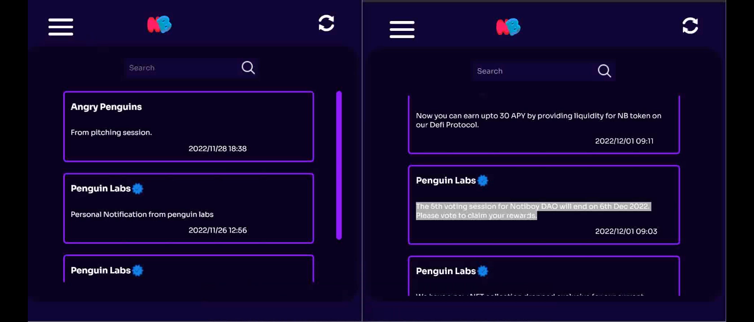

Slide 9
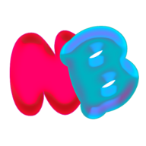
Thank You!
Get in Touch
vidhyanandcs@gmail.com
vidhyanand@notiboy.com
https://notiboy.com

